Slide 1


Miles to Go: Smart Road Trip Planner
Group: 82
Name: Yilin.Li 2255705
Rui.Sang 2251576
Date：2025.5.18

Slide 2
COURSE PRESENTATION TEMPLATE
Part Ａ
Design

Slide 3

TaskＡ－System Design for Route Planning Application
Project Goal：
Build a program to plan optimized road trips in the USA
Users input:
A starting city and destination city
Zero or more attractions they want to visit
Find a route that:
Starts at the origin city
Visits all selected attractions
Ends at the destination
Minimizes the total driving distance
Core Components：
Graph construction using real map data
Shortest path algorithms (Dijkstra, A*)
Attraction ordering (TSP, Nearest Neighbor + 2-opt)
Object-oriented program design

Slide 4
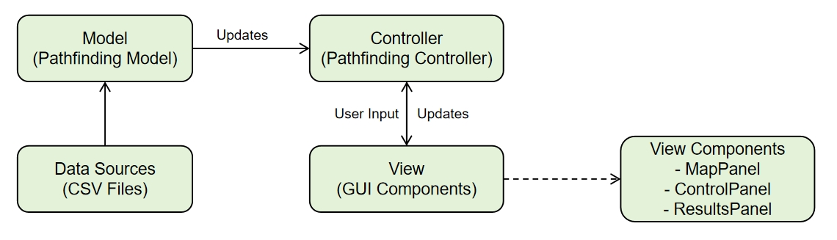
TaskＡ－System Architecture
The application follows a modular architecture:
Figure.8 MVC Architecture of the interaction
Input Layer
Core Logic Layer:
Output Layer
Reads data from attractions.csv and roads.csv
Handles graph creation, route calculation, and attraction ordering
Displays route details and test results

Slide 5
TaskＡ－Data Structure Design
attractions.csv
Stored as: HashMap<String, String>
→ (Attraction Name → City Name)
O(1) lookup speed
Simple and memory-efficient
No need to create complex objects
roads.csv
Stored as: List<DataLoader.RoadConnection>
RoadConnection includes: cityA, cityB, distance
Easy to load line-by-line and transfer to the graph
Graph Representation
Stored as: HashMap<String, Map<String, Integer>>
→ (City → Neighbor → Distance)
Efficient for sparse graphs (US road network)
Fast neighbor access: O(1)
Easy to scale and update
Representation | Space Complexity | Neighbor Access | Edge Lookup | Memory Usage
Adjacency List | O(V+E) | O(1) | O(deg(v)) | low
Adjacency Matrix | O(V²) | O(V) | O(1) | high
Edge List | O(E) | O(E) | O(E) | medium

Slide 6
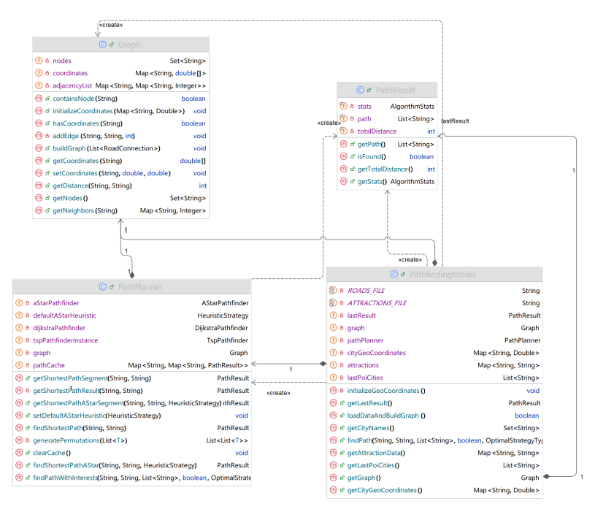
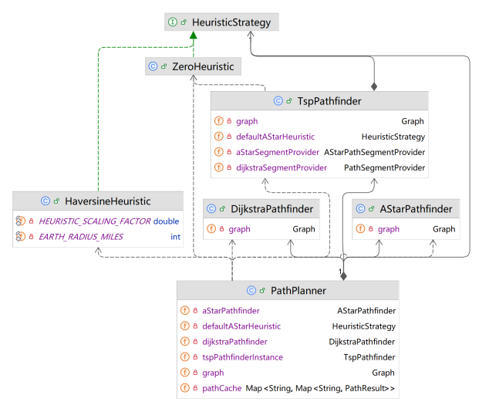
TaskＡ－Class Structure and Interactions
Model Layer
PathfindingModel: Facade for loading data and running pathfinding
Graph: Adjacency list Map<String, Map<String, Integer>>; supports fast neighbor access
PathPlanner: Manages algorithm calls; uses caching for TSP
PathResult: Stores result path, total distance, and stats (immutable)
Figure 2: UML Class Diagram of the Model Components
Algorithm Layer
DijkstraPathfinder / AStarPathfinder: Find shortest path
TspPathfinder:
Exact (permutations)
Approximate (NN + 2-opt)
HeuristicStrategy: Interface (e.g., Haversine, Zero)
Figure 3: UML Class Diagram of the Algorithm Implementations

Slide 7
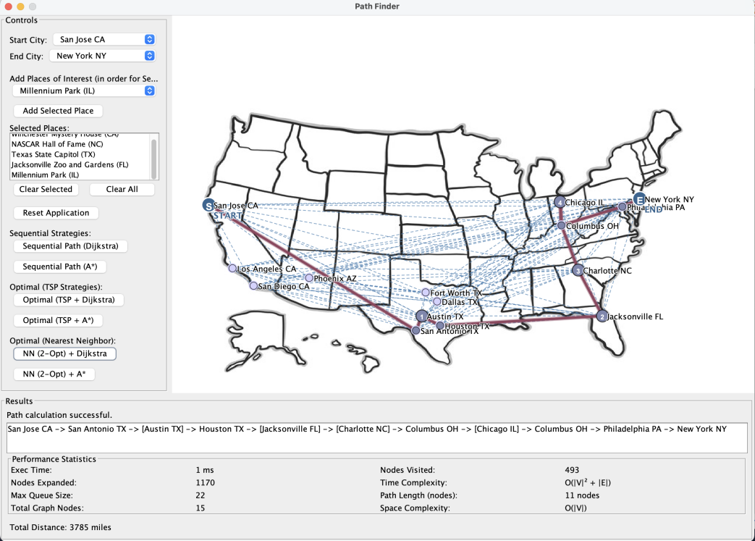
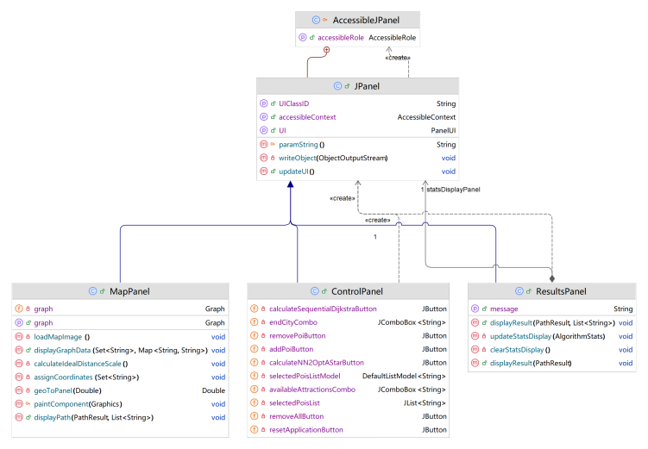
TaskＡ－Class Structure and Interactions
View Layer
MapPanel: Renders cities, roads, and paths
ControlPanel: Receives user input (city/POI selection)
ResultsPanel: Displays route + performance metrics
Figure 4: Class Diagram of the View Components

Slide 8
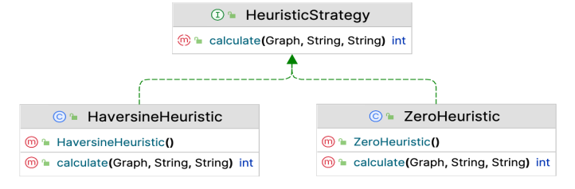
TaskＡ－Application of Object-Oriented Programming (OOP) Principles
public class Graph { private Map<String, Map<String, Integer>> adjacencyList; private Set<String> nodes; private Map<String, double[]> coordinates; // Store coordinates for each city //Constructor initializes an empty graph public Graph() { adjacencyList = new HashMap<>(); nodes = new HashSet<>(); coordinates = new HashMap<>(); }
。。。
}
public void buildGraph(List<RoadConnection> roads) { for (RoadConnection road : roads) { String cityA = road.getCityA(); String cityB = road.getCityB(); int distance = road.getDistance(); // ... // Add edges in the undirected graph addEdge(cityA, cityB, distance); addEdge(cityB, cityA, distance); } }
private void addEdge(String source, String destination, int distance) { adjacencyList.computeIfAbsent(source, k -> new HashMap<>()).put(destination, distance); }
public class PathResult { private final List<String> path; private final int totalDistance;
private final AlgorithmStats stats;
public PathResult(List<String> path, int totalDistance, AlgorithmStats stats) { // Ensure path is unmodifiable and a defensive copy is made this.path = (path != null) ? Collections.unmodifiableList(new ArrayList<>(path)) : Collections.emptyList(); this.totalDistance = totalDistance; this.stats = stats; }
。。。
}
Encapsulation
Each algorithm has its own class (e.g., Dijkstra, A*)
Internal logic hidden; only public methods exposed
PathResult is immutable and safely shared
Abstraction
Interfaces simplify algorithm use
PathResult hides internal logic, only shows results
Inheritance
Heuristics share the HeuristicStrategy interface
UI panels extend JPanel to reuse rendering
Polymorphism
Different algorithms/heuristics used with the same interface
Controller handles them without knowing implementation
(a) . Private fileds example in Graph
(b) . Information hiding example in Graph
(c) . Immutable object example in PathResult
Figure 9 Code example of the application of Encapsulation
public class TspPathfinder { @FunctionalInterface public interface PathSegmentProvider { PathResult getShortestPathSegment(String from, String to); }
@FunctionalInterface public interface AStarPathSegmentProvider { PathResult getShortestPathAStarSegment(String from, String to, HeuristicStrategy strategy); }
...
}
public class DijkstraPathfinder {
...
public PathResult findShortestPath(String start, String end) {
return new PathResult(path, distance, stats);
}
...
}
public class AStarPathfinder {
...
public PathResult findShortestPath(String start, String end) {
return new PathResult(path, distance, stats);
}
...
}
public PathResult findShortestPath(String start, String end) { return dijkstraPathfinder.findShortestPath(start, end); }
public PathResult findShortestPathAStar(String start, String end, HeuristicStrategy heuristicStrategy) { return aStarPathfinder.findShortestPathAStar(start, end, heuristicStrategy); }
(a) . Functional Interface example in TspPathfinder
(b) . Abstraction application in PathResult
Figure.10 Code example of the application of Abstraction
Figure 11 Inheritance hierarchy diagram for Heuristic Strategies

Slide 9
COURSE PRESENTATION TEMPLATE
Part Ｂ
Evaluation

Slide 10
TaskＢ－Algorithm Evaluation: Graph
Path Planning: Two Subproblems
Find the best order to visit all points of interest (POIs)
Find the shortest path between each pair of locations
1.Best Visiting Order
Optimal Visiting Order
TSP (Permutation-Based)
Tries all POI orders → guaranteed optimal
Time complexity: O(n!)
Suitable for ≤10 POIs
Nearest Neighbor + 2-opt
Greedy path + local optimization
Time complexity: O(n²)
Scales better, good approximation
2. Shortest Path Between Two Cities
Dijkstra’s Algorithm
Guarantees shortest path
Time: O((V + E) log V)
Uses priority queue
A Algorithm*
Adds heuristic (Haversine distance)
Same worst-case as Dijkstra
Faster in practice due to goal direction

Slide 11
TaskＢ－Demonstration of Results
Case 1 : Houston TX to Philadelphia PA (No attractions)
For this direct route, the application used Dijkstra's algorithm or A* algorithm to find the shortest path:
Component | Total Distance (miles) | Execute Time (ms) | Nodes Expanded | Max Queue Size | Nodes Visited
Sequential + Dijkstra | 1350 | 2 | 20 | 15 | 12
Sequential + A* | 1350 | 0 | 17 | 14 | 5
Case 2 : Philadelphia PA to San Antonio TX via Hollywood Sign
This case required finding the city where the Hollywood Sign is located Los Angeles CA and calculating the optimal route through this intermediate point:
Component | Total Distance (miles) | Execute Time (ms) | Nodes Expanded | Max Queue Size | Nodes Visited
Sequential + Dijkstra | 3700 | 0 | 52 | 23 | 28
Sequential + A* | 3700 | 0 | 48 | 14 | 7
TSP + Dijkstra | 3700 | 0 | 105 | 21 | 56
TSP + A* | 3700 | 1 | 97 | 14 | 14
NN + Dijkstra | 3700 | 1 | 79 | 21 | 50
NN + A* | 3700 | 0 | 72 | 14 | 10

Slide 12
TaskＢ－Demonstration of Results
Case 3 : San Jose CA to Phoenix AZ via Liberty Bell and Millennium Park
This complex case required determining the optimal order to visit two attractions(Liberty Bell in Philadelphia PA and Millennium Park in Chicago IL):
Component | Total Distance (miles) | Execute Time(ms) | Nodes Expanded | Max Queue Size | Nodes Visited
Sequential + Dijkstra | 4620 | 1 | 72 | 21 | 41
Sequential + A* | 4620 | 0 | 63 | 14 | 13
TSP + Dijkstra | 4620 | 1 | 218 | 21 | 119
TSP + A* | 4620 | 1 | 190 | 14 | 39
NN + Dijkstra | 4620 | 2 | 416 | 23 | 251
NN + A* | 4620 | 1 | 346 | 14 | 75

Slide 13
TaskＢ－Demonstration of Results
Case 4 : Custom Test with Multiple Attractions with 6 attractions
To demonstrate the scalability of our algorithms, we tested a scenario with 6 attractions between New York and Los Angeles:
Component | Total Distance (miles) | Execute Time(ms) | Nodes Expanded | Max Queue Size | Nodes Visited
Sequential + Dijkstra | 7865 | 0 | 142 | 21 | 74
Sequential + A* | 7865 | 0 | 123 | 14 | 22
TSP + Dijkstra | 4215 | 1 | 105491 | 21 | 52117
TSP + A* | 4215 | 2 | 90232 | 14 | 16579
NN + Dijkstra | 4255 | 0 | 3262 | 21 | 1210
NN + A* | 4255 | 1 | 2778 | 14 | 507

Slide 14
TaskＢ－Demonstration of Results
Case 5 : Custom Test with Multiple Attractions with 6 attractions
To demonstrate the scalability of our algorithms, we tested a scenario with 6 attractions between New York and Los Angeles:
Component | Total Distance (miles) | Execute Time(ms) | Nodes Expanded | Max Queue Size | Nodes Visited
Sequential + Dijkstra | 13305 | 1 | 253 | 31 | 126
Sequential + A* | 13415 | 0 | 226 | 14 | 47
TSP + Dijkstra | 4620 | 1327 | 912280512 | 31 | 463034924
TSP + A* | 4620 | 3058 | 804505140 | 14 | 162207388
NN + Dijkstra | 4620 | 1 | 5194 | 31 | 2387
NN + A* | 4620 | 2 | 4649 | 14 | 947

Slide 15
TaskＢ－Algorithm Complexity
Dijkstra’s:
O((V + E) log V)
Searches entire graph with priority queue
Time Complexity
Shortest Path Algorithms
A*:
O((V + E) log V) (worst case)
Faster in practice using Haversine heuristic
A* typically visits fewer nodes than Dijkstra's algorithm for the same problem.
Finding the Optimal Visiting Order
TSP algorithm:
O(n!) only for a small number of POIs
Number of Attractions(k) | Permutation | NN+2-opt
3 | 6 | 9
5 | 120 | 25
7 | 5040 | 49
10 | 3628800 | 100
TSP algorithm:
O(n2) for the Nearest Neighbor and O(n2) for2-opt improvement
much more efficient for larger sets of POIs
Each distance computation in NN2-opt requires a shortest path calculation using either Dijkstra or A* than TSP.
Space Complexity
Graph Representation
Adjacency List: O(V + E)
Nodes set + Coordinates map: O(V)
Component | Time Complexity | Space Complexity
Graph Representation | - | O(V + E)
Dijkstra’s Algorithm | O((V + E) log V ) | O(V )
A* Algorithm | ((V + E) log V ) | O(V )
TSP Strategy | O(k! · (V + E) log V ) | O(k! + V )
NN+2-opt Strategy | O(k² · (V + E) log V ) | O(k! + V )

Slide 16
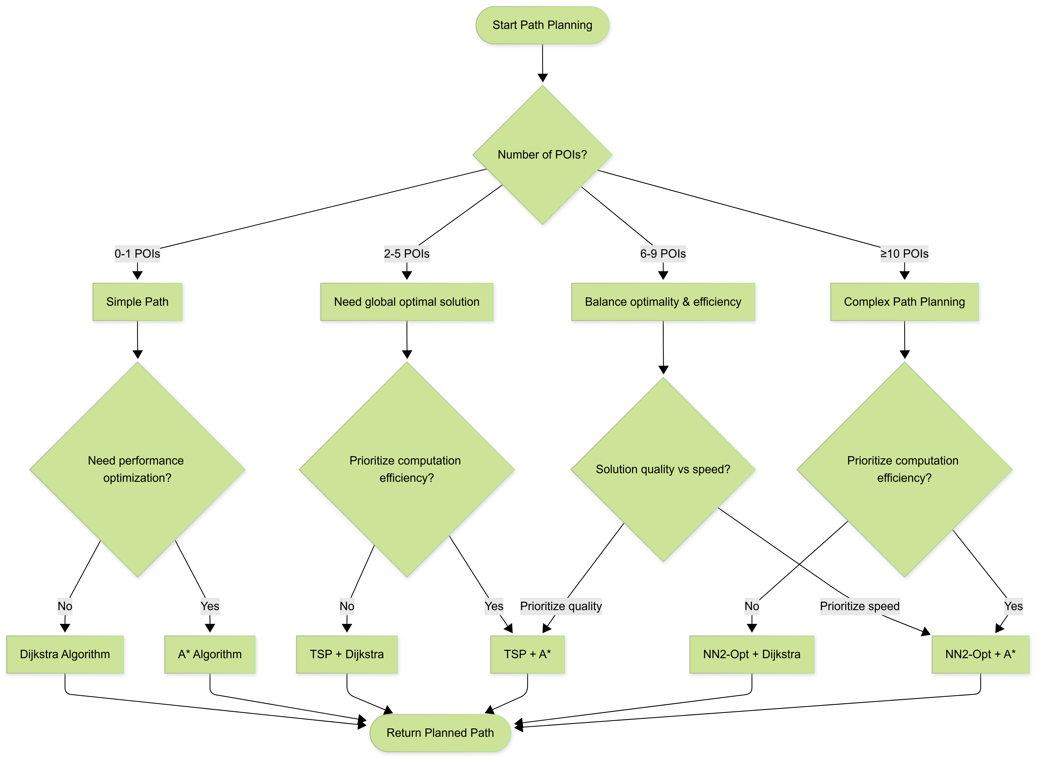
Conclusion

Slide 17
COURSE PRESENTATION TEMPLATE
Part C
Sorting

Slide 18
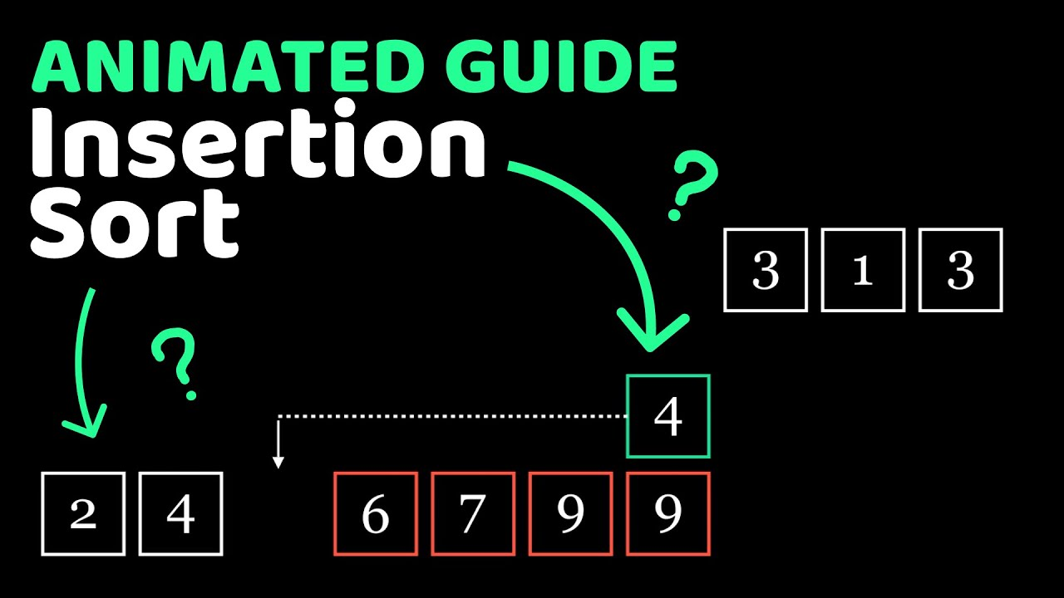
TaskC-Comparing 3 Sorting Method
Insertion Sort:This algorithm goes through the array from left to right. For each element, it places it into the correct position among the elements before it.
It works like sorting playing cards in your hand.
It is done in-place, and best for small or nearly sorted data.
Quick Sort :It picks one element as a pivot and splits the array into two parts: smaller and larger than the pivot. Then it sorts both parts using the same method.
Merge Sort:It keeps splitting the array into halves until each part has one item.
Then it starts merging those small parts back together in the correct order.
It always gives good performance, but it uses extra memory.

Slide 19
TaskC-Testing Result
Dataset | Insertion Sort (ms) | Quick Sort (ms) | Merge Sort (ms)
1000places_sorted | 0.0834 | 2.9082 | 0.3293
1000places_random | 1.9874 | 0.2885 | 0.3610
10000places_sorted | 0.1591 | 191.1221 | 1.6657
10000places_random | 77.1717 | 1.9228 | 2.7346
Strange!
Table 1. Original execution time (ms) before pivot optimization
O(n log n)
Degradation!
Worse
O(n²)

Slide 20
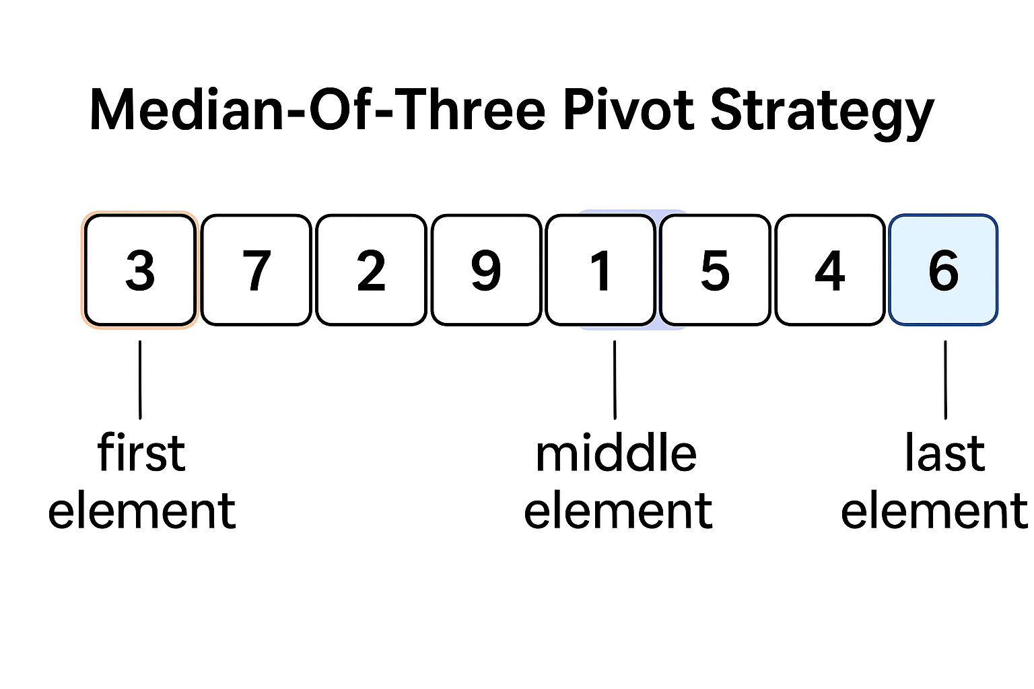
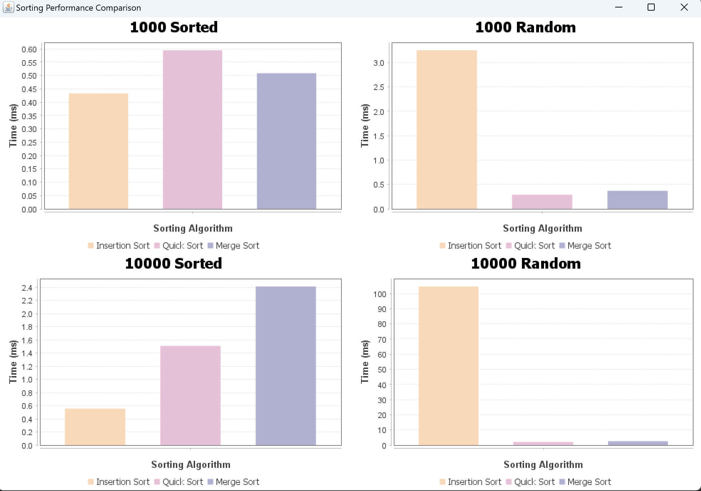
TaskC- Improvement in Quick Sort
Median-Of-Three Pivot Strategy
Datasets | Insertion (ms) | Quick (ms) | Merge (ms)
1000places_sorted | 0.1061 | 0.2180 | 0.3005
1000places_random | 1.7002 | 0.2497 | 0.3860
10000places_sorted | 0.2039 | 1.5032 | 1.6807
10000places_random | 82.0535 | 1.9301 | 2.7548
Table 2. Average execution time (ms) of three sorting algorithms across different datasets (after optimizations)

Slide 21
TaskC-Impact of Input Order on Sorting Performance
Insertion Sort
Best case: Runs in O(n) when data is already sorted (e.g., 1000places_sorted).
Worst case: O(n²) for reversed or random input due to many shifts.
Highly sensitive to input order.
Efficient for partially sorted real-world data (e.g., logs, user activity).
Quick Sort
Generally stable in our tests after pivot optimization.
Classic Quick Sort can degrade to O(n²) on sorted input (if pivot is always last).
Solution: Median-of-three pivot strategy helps prevent this.
Merge Sort
Always splits and merges regardless of input order.
Runs consistently in O(n log n) for both sorted and random inputs.
Good predictability, but uses more memory.

Slide 22
TaskC-Impact of Input Size on Sorting Performance
Insertion Sort
Time Complexity: O(n²)
Random Input:
1000 → 1.70 ms 10000 → 82.05 ms
Sorted Input:
1000 → 0.11 ms 10000 → 0.20 ms
Highly sensitive to input size when disordered
Quick Sort
Time Complexity: O(n log n)
Stable growth:
Random: 0.39 ms → 2.75 ms Sorted: 0.30 ms → 1.68 ms
Consistent performance, predictable scaling
Merge Sort
Time Complexity: Average O(n log n)
Random:0.25 ms → 1.93 ms Sorted:0.22 ms → 1.50 ms
Optimization: Used median-of-three pivot to prevent worst-case O(n²)

Slide 23
TaskC-Sorting Performance with Duplicate Values
Test Setup：
Original datasets had no duplicate values
Created synthetic datasets with only three place names
Dataset sizes: 1000 and 10000 elements
Dataset Size | Insertion Sort | Quick Sort | Merge Sort
1000 items | 5.54 ms | 4.85 ms | 0.82 ms
10000 items | 49.54 ms | 82.67 ms | 2.96 ms
Merge Sort is the best choice for datasets with many duplicates
Insertion Sort suffers from unnecessary shifting
Quick Sort needs improved handling for equal elements
Merge Sort’s consistency and stability make it ideal in such cases

Slide 24
TaskC-Memory Usage Comparison – Method & Results
Test Method：
Tracked extra memory for Merge Sort
Estimated stack usage for Quick Sort via recursion depth
Insertion Sort needs no extra memory
Dataset | Insertion Sort (Extra Memory) | Quick Sort (Stack Usage) | Recursion Depth | Merge Sort (Extra Memory)
1000 Sorted | 0 KB | 0 KB | 9 | 77 KB
1000 Random | 0 KB | 1 KB | 17 | 77 KB
10000 Sorted | 0 KB | 0 KB | 13 | 1043 KB
10000 Random | 0 KB | 1 KB | 22 | 1043 KB
Insertion Sort：No extra memory (O(1))
Quick Sort：Improved by median-of-three pivot Worst-case (not shown): up to 624 KB stack
Merge Sort：Always allocates extra arrays (O(n)) Not ideal for devices with limited memory

Slide 25
COURSE PRESENTATION TEMPLATE
Part D
Conclusion

Slide 26
TaskＤ－AI-Assisted Planning and Collaboration
Tools Used：
Used Trello for weekly task assignment, progress tracking, and code management
Though not AI-powered, features like checklists, timelines, reminders kept us on track
Team Feedback Loop：
Regularly commented and suggested changes on Trello cards
Example: Initial sorting chart was hard to read → revised based on team input
This iterative feedback helped us improve both design and collaboration

Slide 27
TaskＤ－Equality, Diversity, and Inclusion (EDI)
Equality: Same content and layout for all users, regardless of region
Diversity: Aiming to support various languages, color-blind modes, senior-friendly displays
Inclusion: Simple interface so anyone—especially elderly or users with disabilities—can use core features
Challenges: Added development cost, design complexity, and the need for real-user testing

Slide 28

TaskＤ－Reflection & Skills Gained
Improved in algorithm design, Java GUI, and performance testing
Learned to break down problems, work independently, and collaborate in a team setting
Gained experience in real-world development workflows and inclusive design thinking

Slide 29
THANKS for watching

